Slide 1
Linear Time Sorting (Radix Sort)

Slide 2
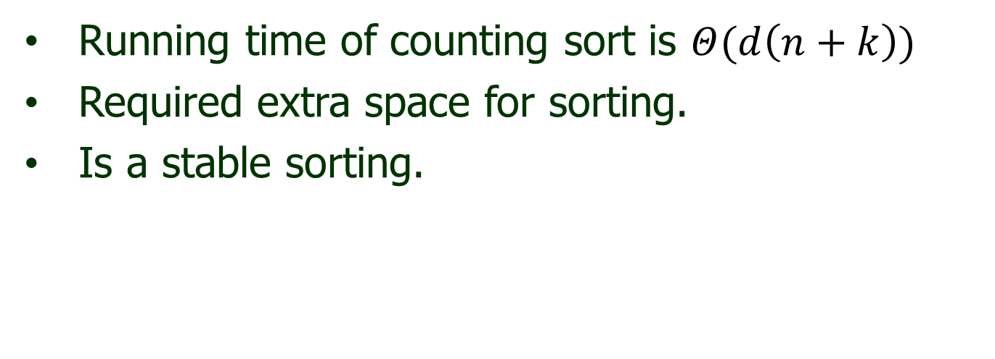
Overview
Running time of counting sort is $Θ(d\left(n+k\right))$
Required extra space for sorting.
Is a stable sorting.

Slide 3
Radix Sort
Radix sort is non comparative sorting method
Two classifications of radix sorts are least significant digit (LSD) radix sorts and most significant digit (MSD) radix sorts.
LSD radix sorts process the integer representations starting from the least digit and move towards the most significant digit. MSD radix sorts work the other way around.

Slide 4
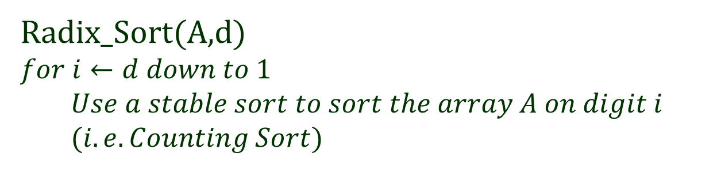
Radix Sort (Algorithm)
Radix_Sort(A,d)
$$for i←d down to 1$$
$$Use a stable sort to sort the array A on digit i$$
$$(i.e. Counting Sort)$$

Slide 5
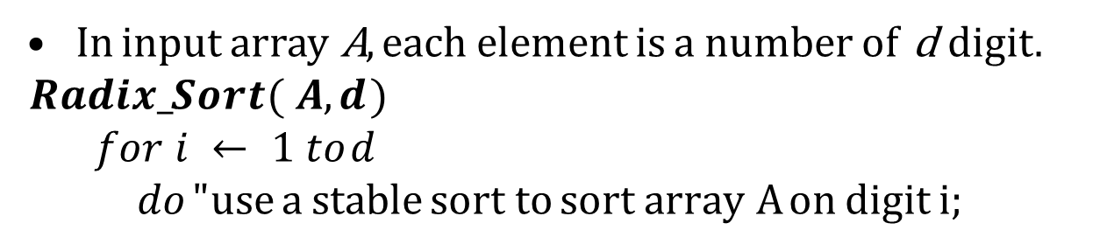
Radix Sort
In input array A, each element is a number of d digit. $Radix_Sort( A, d )$
$$for i ← 1 to d$$
$$do " use a stable sort to sort array A on digit i;$$
329
457
657
839
436
720
355

Slide 6
Radix Sort
In input array A, each element is a number of d digit. $Radix_Sort( A, d )$
$$for i ← 1 to d$$
$$do " use a stable sort to sort array A on digit i;$$
329 |  | 720
457 |  | 355
657 |  | 436
839 |  | 457
436 |  | 657
720 |  | 329
355 |  | 839

Slide 7
Radix Sort
In input array A, each element is a number of d digit. $Radix_Sort( A, d )$
$$for i ← 1 to d$$
$$do " use a stable sort to sort array A on digit i;$$
329 |  | 720 |  | 720
457 |  | 355 |  | 329
657 |  | 436 |  | 436
839 |  | 457 |  | 839
436 |  | 657 |  | 355
720 |  | 329 |  | 457
355 |  | 839 |  | 657

Slide 8
Radix Sort
In input array A, each element is a number of d digit. $Radix_Sort( A, d )$
$$for i ← 1 to d$$
$$do " use a stable sort to sort array A on digit i;$$
329 |  | 720 |  | 720 |  | 329
457 |  | 355 |  | 329 |  | 355
657 |  | 436 |  | 436 |  | 436
839 |  | 457 |  | 839 |  | 457
436 |  | 657 |  | 355 |  | 657
720 |  | 329 |  | 457 |  | 720
355 |  | 839 |  | 657 |  | 839

Slide 9
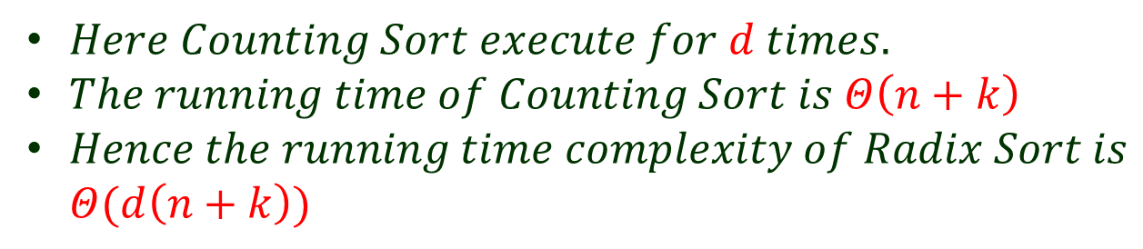
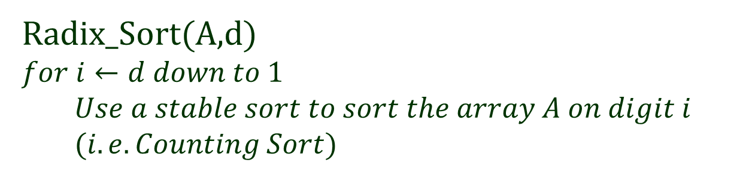
Radix Sort (Analysis)
Radix_Sort(A,d)
$$for i←d down to 1$$
$$Use a stable sort to sort the array A on digit i$$
$$(i.e. Counting Sort)$$
$Here Counting Sort execute for d times.$
$The running time of Counting Sort is Θ\left(n+k\right)$
$Hence the running time complexity of Radix Sort is$
$Θ(d\left(n+k\right))$

